Slide 1
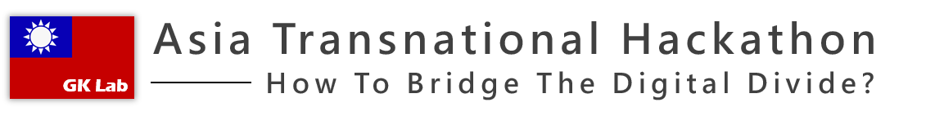
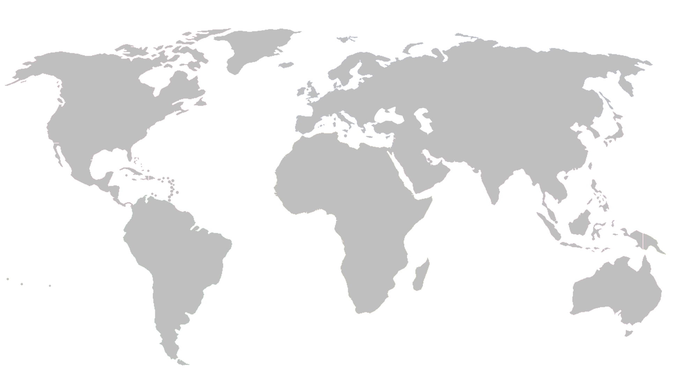
Taiwan
Asia Transnational Hackathon
GK Lab
蔡宗勳
盧國峯
TSAI,TSUNG-HSUN
LU,KUO-FENG

Slide 2



How
To Bridge The Digital Divide?
TSAI,TSUNG-HSUN

Slide 3

TSAI,TSUNG-HSUN
Education gap
Education gap has been a long-standing problem, many educators put a lot of effort and and want to change it.

Slide 4


Shorten
The gap between urban and rural areas.
TSAI,TSUNG-HSUN

Slide 5




縣市各級學校數位教育設備
各縣市無線網路普及率
Open Data
Usage
個學術網路使用量
資訊教師分佈
各國資訊教育落差
TSAI,TSUNG-HSUN

Slide 6

TSAI,TSUNG-HSUN
Live Demo

Slide 7
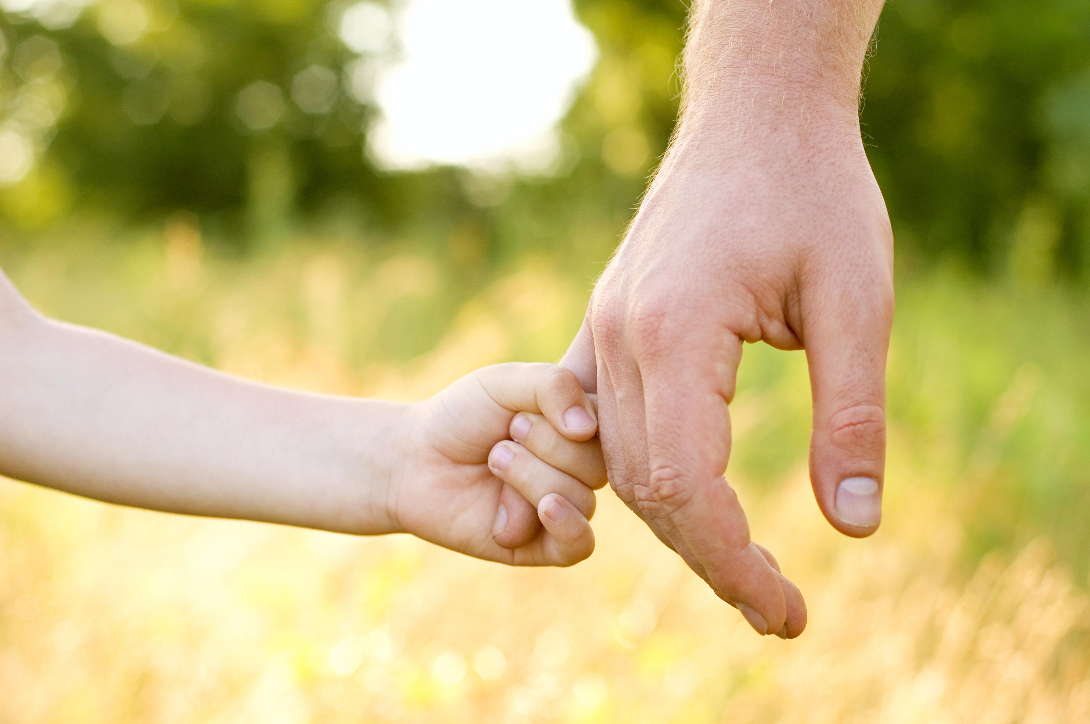

THANK YOU
TSAI,TSUNG-HSUN
LU,KUO-FENG

